Slide 1
Basic Electronics Engineering FE 2024 Course
Presented by
Mr. Aniruddha Nirmal
Assistant Professor
Department of First Year Engineering
DPCOE Pune

Slide 2
Unit I : Introduction to Electronics
Syllabus
Evolution of Electronics
Impact of Electronics in industry and in society
Introduction to active and passive components
P-type Semiconductor, N-type Semiconductor
Current in semiconductors (Diffusion and Drift Current)
Diodes and Its Applications:
P-N Junction diode construction and its working in forward and reverse bias condition,
V-I characteristics of P-N junction Diode
Diode as a switch
Half Wave Rectifier
Full wave
Bridge Rectifier
Special purpose diodes:
Zener diode
Light Emitting Diode (LED)
Photo diode

Slide 3
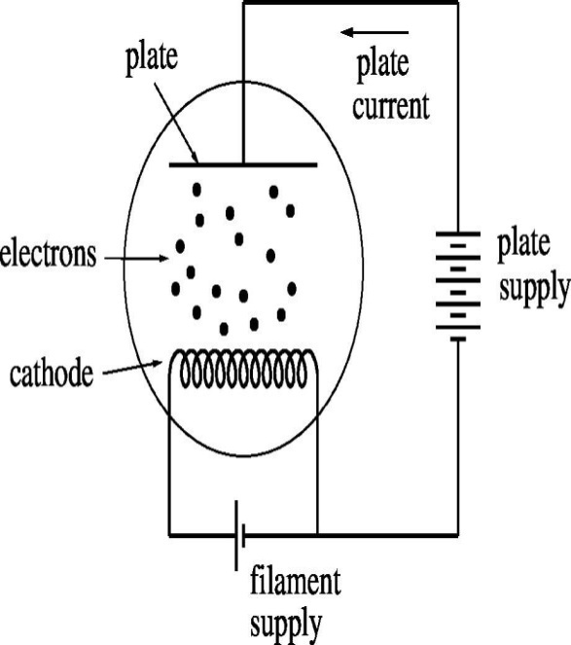
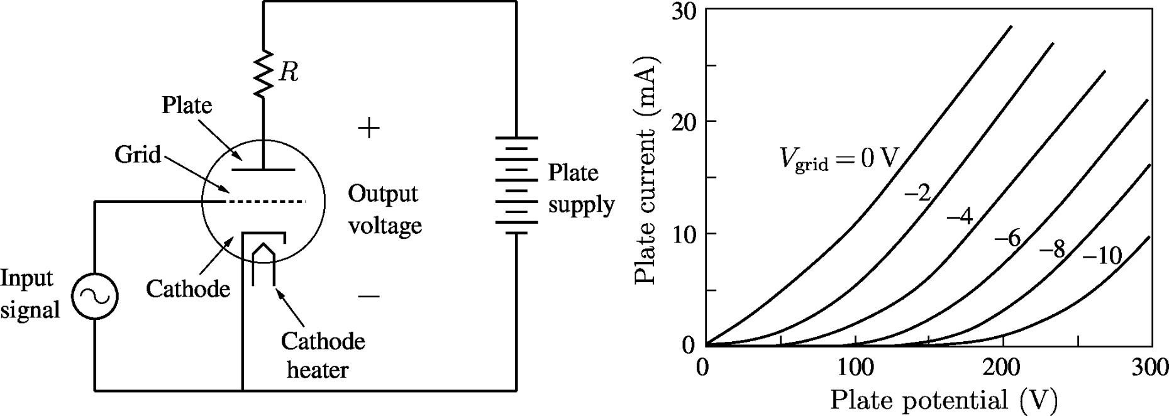
Evolution of Electronics Vacuum tubes
1904: the simplest vacuum tube – the diode – was invented by John Fleming.
1907: De Forest invented the triode by inserting a third electrode between cathode and anode.

Slide 4
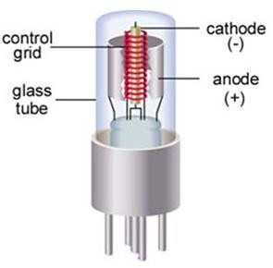
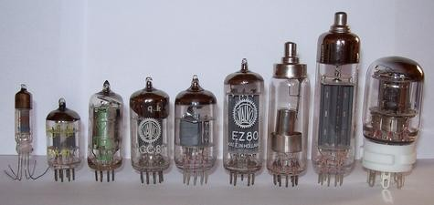
Vacuum Tubes

Slide 5
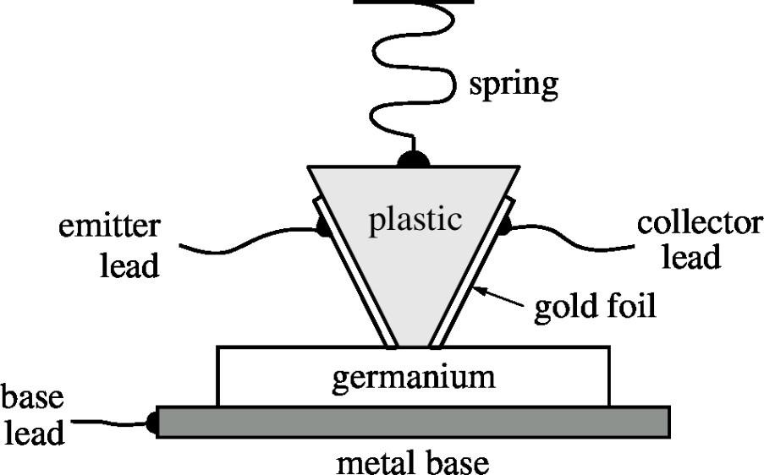
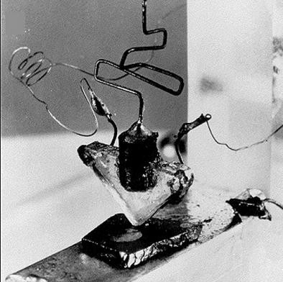
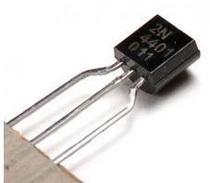
The first transistor
The vacuum tube was a bulky and fragile device which consumed a significant power.
1947: Shockley, Bardeen, and Brattain at Bell Labs invented the first transistor.
The first transistor was a “point contact transistor.” The modern transistor is a junction transistor, and it is monolithic (in the same semiconductor piece).

Slide 6
Semiconductor technology
The bipolar transistor continues to be an important device both as
a discrete device and as part of Integrated Circuits (IC).
However, in digital circuits such as processors and memory, the MOS (Metal Oxide Semiconductor) field-effect transistor has surpassed the bipolar transistor because of the high integration density and low power consumption it offers.
1930: patent filed by Lilienfeld for field-effect transistor (FET).
1958: Jack Kilby (Texas Instruments) demonstrated the first integrated circuit (bipolar transistor, resistor, capacitor) fabricated on a single piece of germanium.
The rest is history!

Slide 7
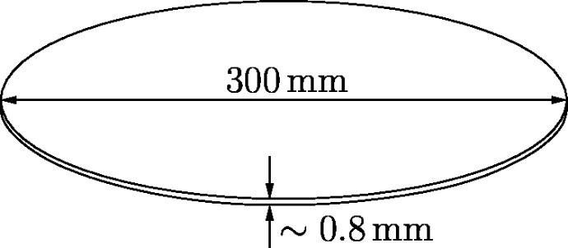
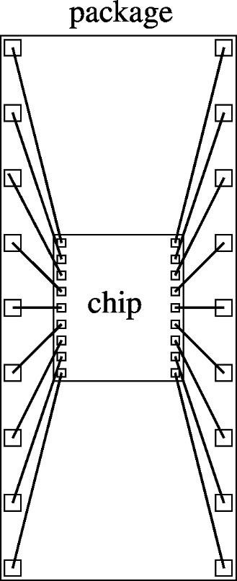
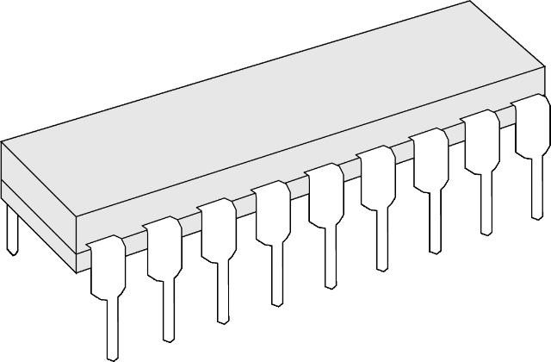

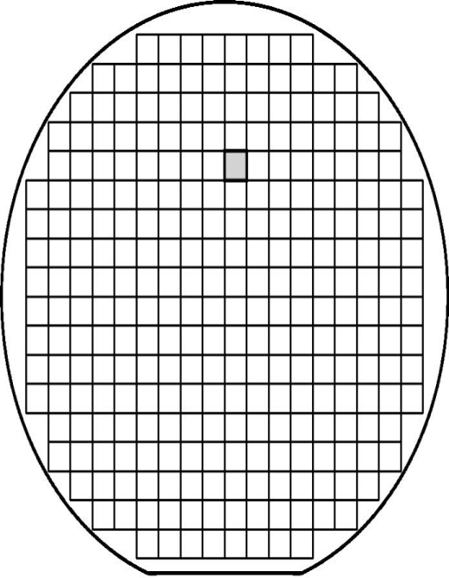
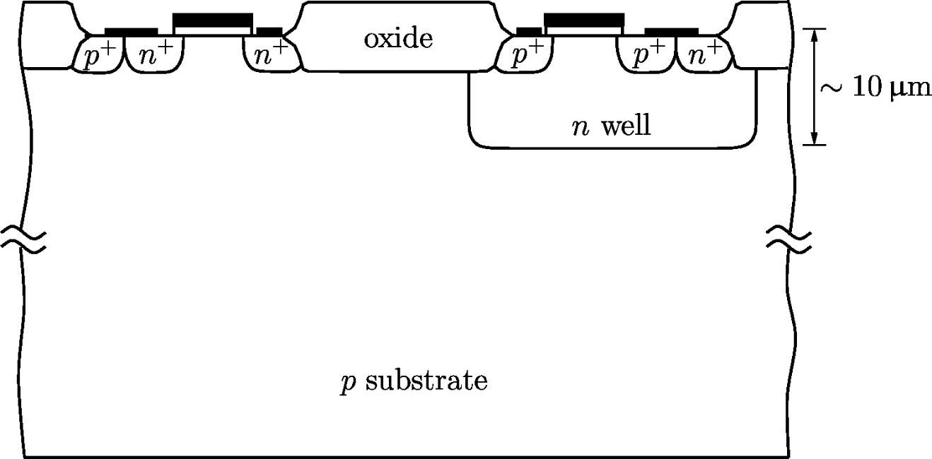
Semiconductor technology

Slide 8


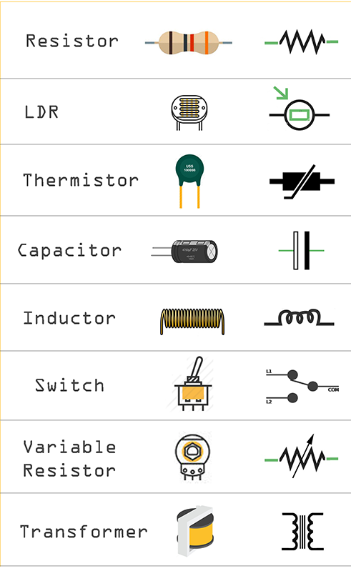
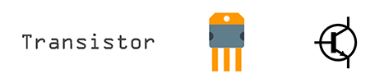

Active and passive components
BJT, JFET, MOSFET

Slide 9
Difference between active & Passive components
Characteristics/ Parameters | Active component | Passive component
Energy or Power | Delivers energy or power to the circuit | Consumes energy or power in the circuit
Operational Requirements | Requires external source to their operation | Does not require any external source to their operation
Power gain | Capable of providing power gain (just like an amplifier) | Cannot provide any power gain
Energy Storage | Cannot store the energy | Can store the energy (in case of inductor and capacitor)
Current Flow | Capable to control the flow of current in the circuit | Cannot control the flow of current in the circuit
Amplification | Can produce amplification | Cannot produce amplification
Direction of operation | Unidirectional | Bidirectional
Elements (examples) | Includes diodes, transistors, voltage or current sources etc. | Includes resistor, capacitor, inductor, transformer, transducer etc.

Slide 10
Introduction to semiconductor physics
parameter | Conductor | Semi conductor | insulator
No. of valance electrons | 3 or less than 3 | 4 | 5 or more than 5
conductivity | high | medium | negligible
Semi Conductor Types
Intrinsic
Extrinsic
P type
N type

Slide 11
Semi-conductor types
Intrinsic Semi-Conductor
Dopping
(with Impurity)
Extrinsic
Semi-Conductor
Intrinsic Semi-Conductor
Trivalent Impurity
P Type
Semi-Conductor
Intrinsic Semi-Conductor
Pentavalent
Impurity
N Type
Semi-Conductor

Slide 12
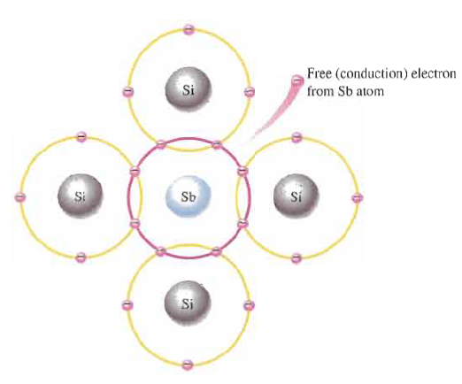
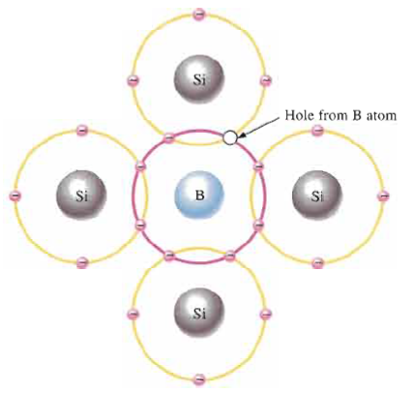
N type semi-conductor
P type semi-conductor
Pentavalent
(Donor) impurity
Trivalent
(Acceptor) impurity
Arsenic (As)
Phosphorus (P)
Antimony(Sb)
Bismuth(Bi)
Boron (B)
Indium (In)
Gallium (Ga)

Slide 13
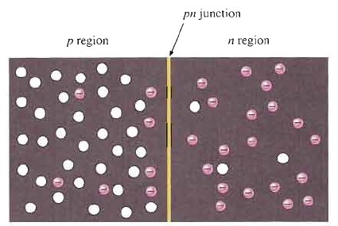
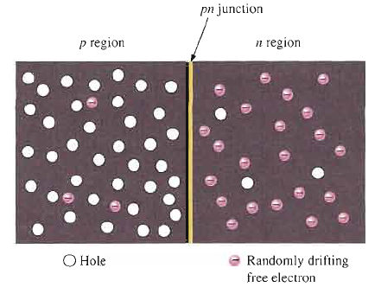

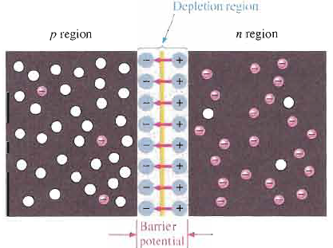
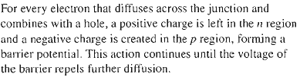
P-N Junction (Diode)

Slide 14
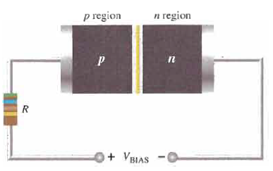
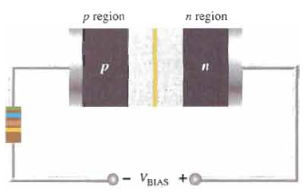
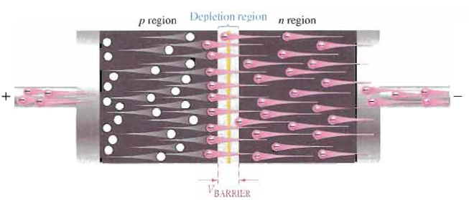
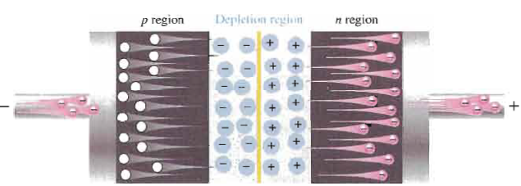
Diode Working
Forward Bias Reverse Bias

Slide 15
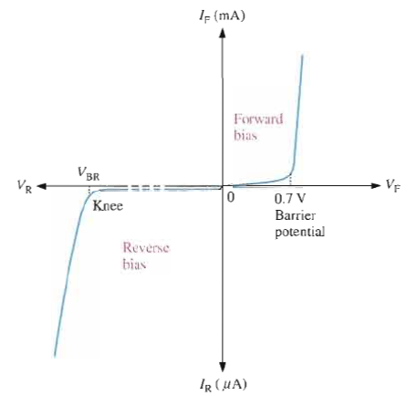
Voltage Current Characteristic

Slide 16
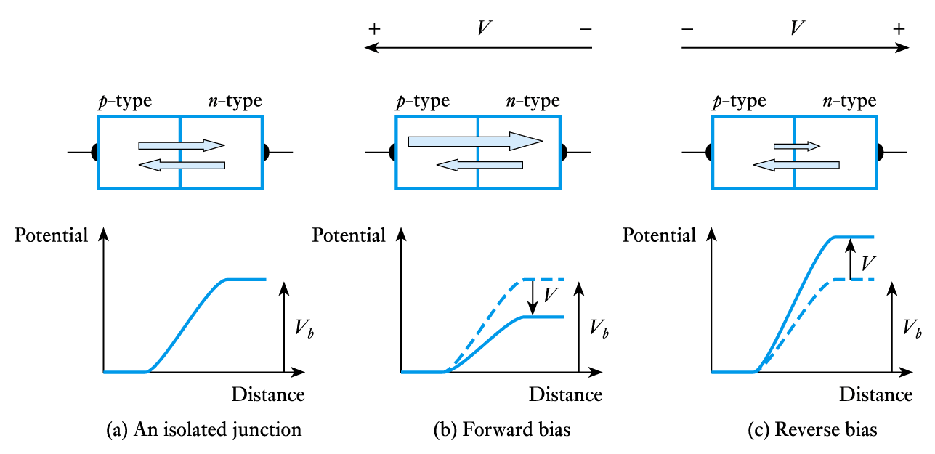
Currents in a P-N junction

Slide 17
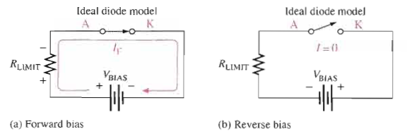
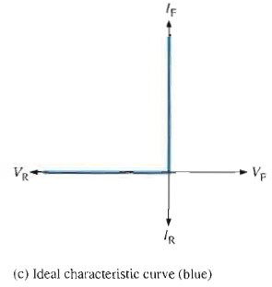
Diode as a Switch

Slide 18
Diode as Rectifier
It is a circuit which converts AC into pulsating DC
Rectifier
HWR
FWR-CTT
FWR-Bridge

Slide 19
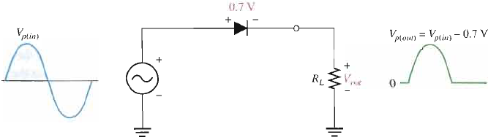
Half Wave Rectifier

Slide 20
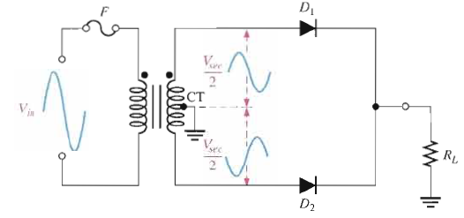
Center Tapped –Full Wave Rectifier

Slide 21
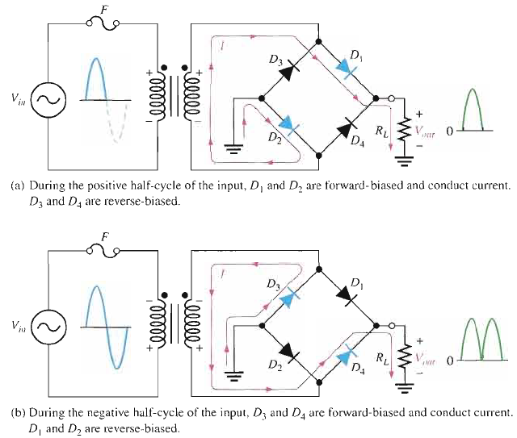
Bridge Rectifier

Slide 22


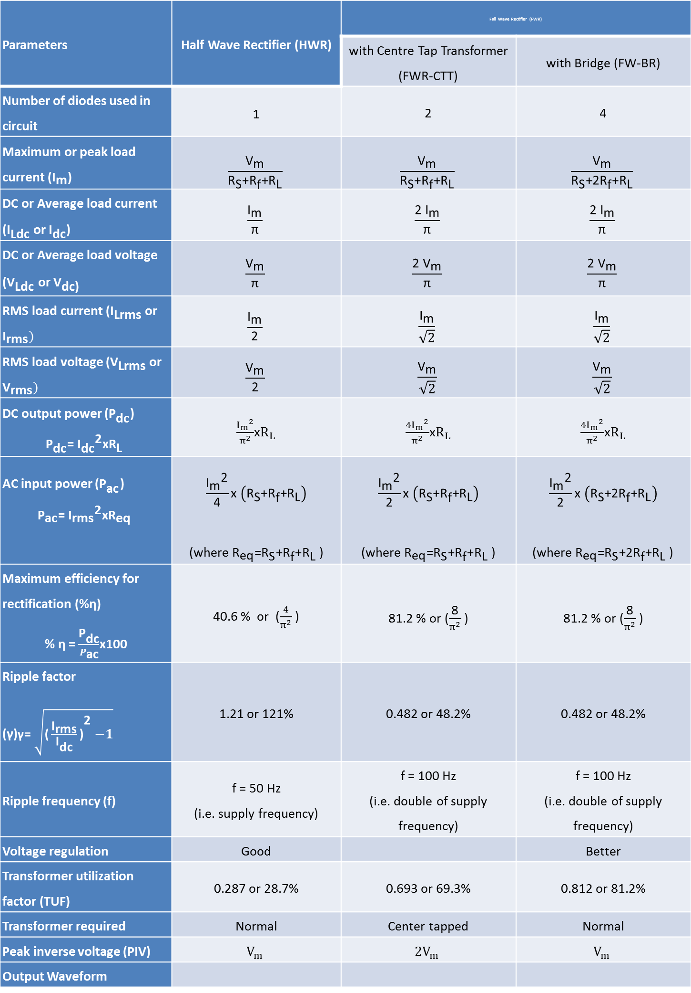
Comparison of HWR and FWR
Parameters | Half Wave Rectifier (HWR) | Full Wave Rectifier (FWR)
 |  | with Centre Tap Transformer (FWR-CTT) | with Bridge (FW-BR)
Number of diodes used in circuit | 1 | 2 | 4
Maximum or peak load current (${\text{I}}_{\text{m}}$) | $$\frac{{\text{V}}_{\text{m}}}{{\text{R}}_{\text{S}}\text{+}{\text{R}}_{\text{f}}\text{+}{\text{R}}_{\text{L}}}$$ | $$\frac{{\text{V}}_{\text{m}}}{{\text{R}}_{\text{S}}\text{+}{\text{R}}_{\text{f}}\text{+}{\text{R}}_{\text{L}}}$$ | $$\frac{{\text{V}}_{\text{m}}}{{\text{R}}_{\text{S}}\text{+}{\text{2}\text{R}}_{\text{f}}\text{+}{\text{R}}_{\text{L}}}$$
DC or Average load current (${\text{I}}_{\text{Ldc}}$ or ${\text{I}}_{\text{dc}}$) | $$\frac{{\text{I}}_{\text{m}}}{\text{π}}$$ | $$\frac{{\text{2 }\text{I}}_{\text{m}}}{\text{π}}$$ | $$\frac{{\text{2 }\text{I}}_{\text{m}}}{\text{π}}$$
DC or Average load voltage (${\text{V}}_{\text{Ldc}}$ or ${\text{V}}_{\text{dc}\text{)}}$ | $$\frac{{\text{V}}_{\text{m}}}{\text{π}}$$ | $$\frac{{\text{2 }\text{V}}_{\text{m}}}{\text{π}}$$ | $$\frac{{\text{2 }\text{V}}_{\text{m}}}{\text{π}}$$
RMS load current (${\text{I}}_{\text{Lrms}}$ or ${\text{I}}_{\text{rms}})$ | $$\frac{{\text{I}}_{\text{m}}}{\text{2}}$$ | $$\frac{{\text{I}}_{\text{m}}}{\sqrt{2}}$$ | $$\frac{{\text{I}}_{\text{m}}}{\sqrt{2}}$$
RMS load voltage (${\text{V}}_{\text{Lrms}}$ or ${\text{V}}_{\text{rms}})$ | $$\frac{{\text{V}}_{\text{m}}}{\text{2}}$$ | $$\frac{{\text{V}}_{\text{m}}}{\sqrt{2}}$$ | $$\frac{{\text{V}}_{\text{m}}}{\sqrt{2}}$$
DC output power ${\text{(}\text{P}}_{\text{dc}}$) ${\text{P}}_{\text{dc}}$=${{ \text{I}}_{\text{dc}}}^{\text{2}}\text{x}{\text{R}}_{\text{L} }$ | $\frac{{I_{m}}^{2}}{π^{2}}$x$R_{L}$ | $\frac{{{4I}_{m}}^{2}}{π^{2}}$x$R_{L}$ | $\frac{{{4I}_{m}}^{2}}{π^{2}}$x$R_{L}$
AC input power ${\text{(}\text{P}}_{\text{ac}}$) ${\text{P}}_{\text{ac}}$=${{ \text{I}}_{\text{rms}}}^{\text{2}}\text{x}{\text{R}}_{\text{eq} }$ | $$\frac{{{\text{I}}_{\text{m}}}^{\text{2}}}{\text{4}}\text{x} \left({\text{R}}_{\text{S}}\text{+}{\text{R}}_{\text{f}}\text{+}{\text{R}}_{\text{L}}\right)$$ (where ${\text{R}}_{\text{eq}}\text{=}{\text{R}}_{\text{S}}\text{+}{\text{R}}_{\text{f}}\text{+}{\text{R}}_{\text{L} }\text{)}$ | $$\frac{{{\text{I}}_{\text{m}}}^{\text{2}}}{\text{2}}\text{x} \left({\text{R}}_{\text{S}}\text{+}{\text{R}}_{\text{f}}\text{+}{\text{R}}_{\text{L}}\right)$$ (where ${\text{R}}_{\text{eq}}\text{=}{\text{R}}_{\text{S}}\text{+}{\text{R}}_{\text{f}}\text{+}{\text{R}}_{\text{L} }\text{)}$ | $$\frac{{{\text{I}}_{\text{m}}}^{\text{2}}}{\text{2}}\text{x} \left({\text{R}}_{\text{S}}\text{+}{\text{2}\text{R}}_{\text{f}}\text{+}{\text{R}}_{\text{L}}\right)$$ (where ${\text{R}}_{\text{eq}}\text{=}{\text{R}}_{\text{S}}\text{+2}{\text{R}}_{\text{f}}\text{+}{\text{R}}_{\text{L} }\text{)}$
Maximum efficiency for rectification (%η) % η = $\frac{{\text{P}}_{\text{dc}}}{P_{\text{ac}}}$x100 | 40.6 % or ($\frac{4}{π^{2}}$ ) | 81.2 % or ($\frac{\text{8}}{π^{2}}$ ) | 81.2 % or ($\frac{\text{8}}{π^{2}}$ )
Ripple factor (γ)$\text{γ}\text{= }\sqrt{{\text{(}\frac{{\text{I}}_{\text{rms}}}{{\text{I}}_{\text{dc}}}\text{)}}^{\text{2 }}−1}$ | 1.21 or 121% | 0.482 or 48.2% | 0.482 or 48.2%
Ripple frequency (f) | f = 50 Hz (i.e. supply frequency) | f = 100 Hz (i.e. double of supply frequency) | f = 100 Hz (i.e. double of supply frequency)
Voltage regulation | Good |  | Better
Transformer utilization factor (TUF) | 0.287 or 28.7% | 0.693 or 69.3% | 0.812 or 81.2%
Transformer required | Normal | Center tapped | Normal
Peak inverse voltage (PIV) | $$V_{m}$$ | $${2V}_{m}$$ | $$V_{m}$$
Output Waveform

Slide 23
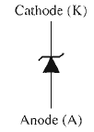
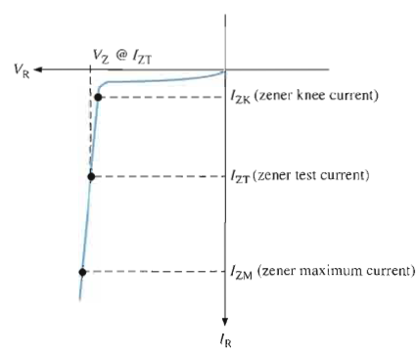
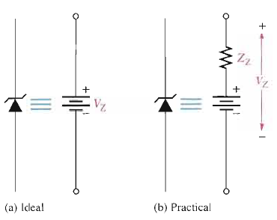
Special Purpose Diode: Zener Diode

Slide 24
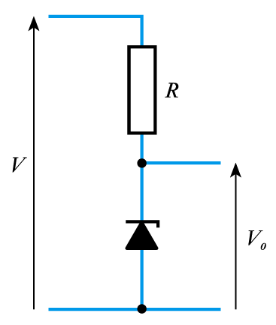
Special Purpose Diode: Zener Diode
Features:
Uses the relatively constant reverse breakdown voltage to produce a voltage reference.
Breakdown voltage is called the Zener voltage, V_{Z}
Output voltage of circuit shown is equal to V_{Z} despite variations in input voltage V
A resistor is used to limit the current in the diode

Slide 25
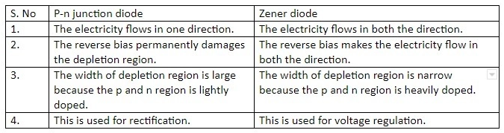
Difference between zener & PN Junction Diodes

Slide 26
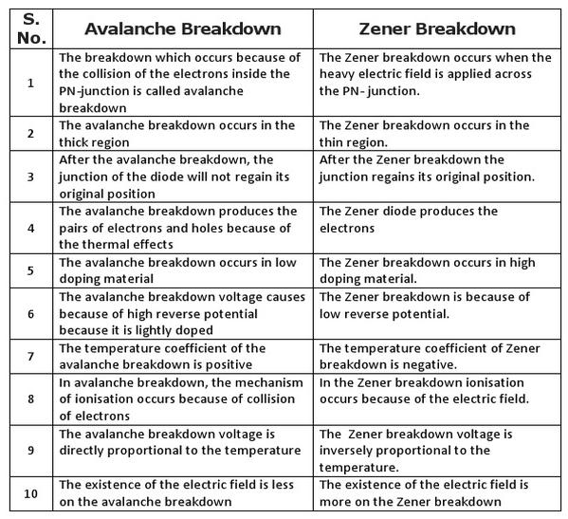
Difference between Avalanche and Zener breakdown

Slide 27
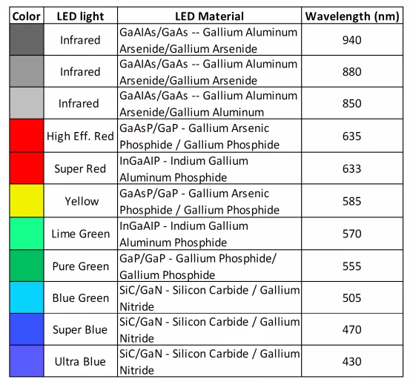

Light Emitting Diode (LED)

Slide 28
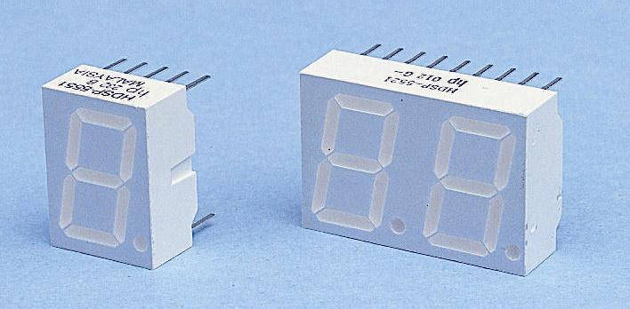
Special-Purpose Diodes
Light-emitting diodes
discussed earlier when we looked at light actuators

Slide 29
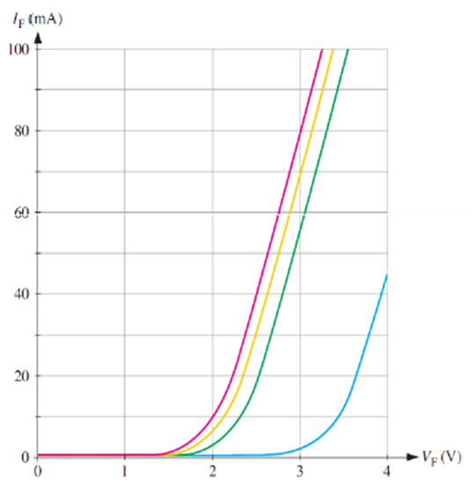
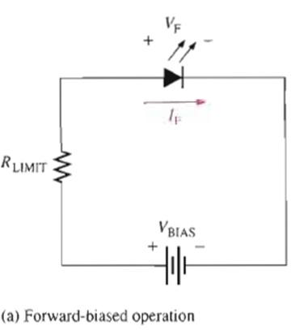
LED Working

Slide 30
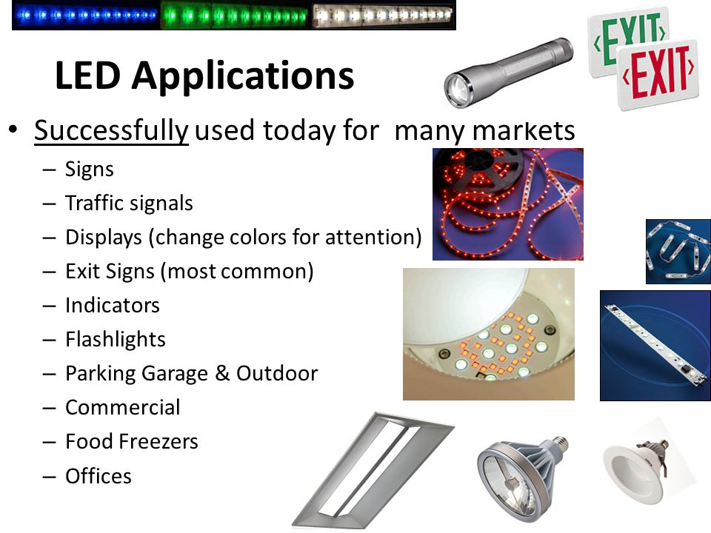

Slide 31
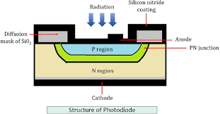

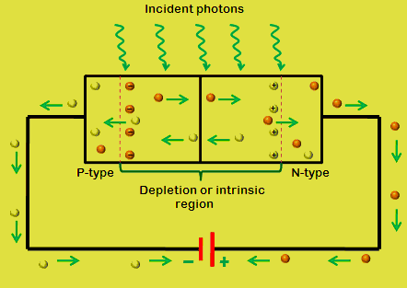
Photo Diode

Slide 32
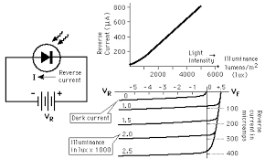
Photo Diode Characteristics

Slide 33
Key Points
Diodes allow current to flow in only one direction
At low temperatures semiconductors act like insulators
At higher temperatures they begin to conduct
Doping of semiconductors leads to the production of p-type and n-type materials
A junction between p-type and n-type semiconductors has the properties of a diode
Silicon semiconductor diodes approximate the behavior of ideal diodes but have a conduction voltage of about 0.7 V
There are also a wide range of special purpose diodes
Diodes are used in a range of applications

Slide 34
THANK YOU

